Slide 1
National Business Institute (NBI) Plaintiff’s Personal Injury: Advanced Practice
Section IV. Evidence: Overcoming Admission Hurdles with Medical Bills and Records
By: Paul Kouri
December 18, 2017
Oklahoma City, Oklahoma

Slide 2
NBI-Plaintiff’s Personal Injury: Advanced Practice--Evidence
Notes:
First topic: Collateral Source Rule
Sorry, that image is the one from the seminar next door
Defense Personal Injury Practice

Slide 3
NBI-Plaintiff’s Personal Injury: Advanced Practice--Evidence
C. The Collateral Source Rule.
Upon commission of a tort it is the duty of the wrongdoer to answer for the damages wrought by his wrongful act, and that is measured by the whole loss so caused and the receipt of compensation by the injured party from a collateral source wholly independent of the wrongdoer does not operate to lessen the damages recoverable from the person causing the injury. Denco Bus Lines v. Hargis, 1951 OK 11, 229 P.2d 560.
Notes:
Oklahoma long applied Collateral Source Rule: Early case: Denco Bus Lines v. Hargis, 1951
The rule is that damages in tort are the entire loss cause by TF
And if any damages paid by source other than TF, TF does not get the benefit of those payments
Which are called a “collateral source”

Slide 4
NBI-Plaintiff’s Personal Injury: Advanced Practice--Evidence
Still the rule:
C&H Power Line Const. Co. v. Enterprise Products Operating, LLC, 2016 OK 102, ¶21, 386 P.3d 1027:
Oklahoma still recognizes rule that insurance payment evidence violates collateral source rule, citing Estrada v. Port City Properties, Inc., 2011 OK 30, ¶ 27, 258 P.3d 495,505.
Notes:
Oklahoma still applies collateral source rule. We see that in the 2016 case of
C&H Power Line Const. Co. v. Enterprise Products Operating
We will get into our paid versus incurred statute later, 12 O.S. 3009.1, but
When that statue does not apply, the default rule is the collateral source rule

Slide 5
NBI-Plaintiff’s Personal Injury: Advanced Practice--Evidence
Doesn’t the collateral source rule provide a windfall to the Plaintiff?
Notes:
The rule seems contrary to rules against double recovery and “windfall,”
but public policy says if there will be a “windfall,” the windfall is to go to the innocent
(or more innocent) plaintiff, than to the wrongful TF party.

Slide 6
NBI-Plaintiff’s Personal Injury: Advanced Practice--Evidence
Doesn’t the collateral source rule provide a windfall?
Perhaps
There is a windfall regardless. To whom should it flow?
Notes:
Particularly, I think, when injured plaintiff had foresight to buy insurance.
injured party’s premium should not flow to benefit of tortfeasor.
rationale also explained as mechanism to offset burden of proof
Which often prevents plaintiff from fully recovering all damages.

Slide 7
NBI-Plaintiff’s Personal Injury: Advanced Practice--Evidence
The Rule applies to:
workers comp health insurance disability coverage
life insurance UM sick and vacation pay
salary paid during convalescence Other
If the payment not from Defendant, it is inadmissible
Notes:
Rule applies: WC benefits, health insurance subject to 12 O.S. 3009.1 below
disability, life insurance, UM, sick and vacation pay, salary during convalescence, etc.
If payment not from Defendant, the jury should not hear of it

Slide 8
NBI-Plaintiff’s Personal Injury: Advanced Practice--Evidence
MedMal has a “Special Law,” er, I mean, is a “Special Case””
63 O.S. 1-1708:
A. In every medical liability action, the court shall admit evidence of payments of medical bills made to the injured party, unless the court makes the finding described in paragraph B of this section.
B. In any medical liability action, upon application of a party, the court shall make a determination whether amounts claimed by a health care provider to be a payment of medical bills from a collateral source is subject to subrogation or other right of recovery. If the court makes a determination that any such payment is subject to subrogation or other right of recovery, evidence of the payment from the collateral source and subject to subrogation or other right of recovery shall not be admitted.
Notes:
“special” abrogation of the rule in medical negligence cases, 63 O.S. 1-1708:
In med mal court has to admit evidence of payment of medical bills unless
The injured party shows there is subrogation. If so, payment inadmissible
I don’t do med mal, but suspect there is usually subrogation and the payment is excluded
If I did do med mal I might wonder if this is not a law of particular application
that would apply over the more general rule found in 3009.1

Slide 9
NBI-Plaintiff’s Personal Injury: Advanced Practice--Evidence
51 O.S. 155 absolves governmental entities where there is workers’ compensation available to the injured party
That can be seen as an abrogation of the collateral source rule
Notes:
There is another statutory exception to collateral source in OGTCA at 51 O.S. 155
Gov. entity is simply absolved of liability where injured person has access to comp
case law, exception applies regardless whether the governmental entity provides the comp

Slide 10
NBI-Plaintiff’s Personal Injury: Advanced Practice--Evidence
Collateral Source Rule
Applies to remarriage of injured party
Kimery v. Public Service Co., 1980 OK 187, 622 P.2d 1066.
Notes:
The rule even keeps out evidence of remarriage of the injured party.
Kimery v. Public Service Co., 1980 OK 187, 622 P.2d 1066.

Slide 11
NBI-Plaintiff’s Personal Injury: Advanced Practice--Evidence
The Rule has been eroded where the “collateral benefit” is not the result of the Plaintiff’s efforts either.
See, e.g., Bozeman v. Louisiana, 879 So.2d 692 (La. 2004).
Notes:
collateral source rule eroded (even apart from “paid versus incurred”)
where the collateral benefit is not tied in some way to plaintiff’s efforts.
payment by Medicare is a collateral source since plaintiff’s years of employment,
few courts say same is not so with respect to gratuitous benefits such as Medicaid.
See, e.g., Bozeman v. Louisiana, 879 So.2d 692 (La. 2004).

Slide 12
NBI-Plaintiff’s Personal Injury: Advanced Practice--Evidence
D. Getting Medical Bills Into Evidence.
Notes:
Moving on to the next topic
Getting medical bills admitted

Slide 13
NBI-Plaintiff’s Personal Injury: Advanced Practice--Evidence
D. Getting Medical Bills Into Evidence.
12 O.S. 3009:
Upon the trial of any civil case involving injury … the patient … shall be a competent witness to identify doctor bills … upon a showing by the witness that such bills were received from a licensed practicing physician … and that such expenses were incurred in connection with the treatment of the injury . . . involved in the subject of litigation at trial. Such items of evidence need not be identified by the person who submits the bill, and it shall not be necessary for an expert witness to testify that the charges were reasonable and necessary.
Notes:
We have statute lets patient/plaintiff introduce medical bills: 12 O.S. 3009:
patient, family member, or person responsible for care Can introduce
beauty of this statute is that you don’t have to put on evidence that the bills
Are reasonable and necessary. I find it’s often hard to get your treating doctor
To talk about the bills because they don’t do the billing.

Slide 14
NBI-Plaintiff’s Personal Injury: Advanced Practice--Evidence
Notes:
So, can get bills into evidence with patient’s testimony “these are the bills.”
No need for expert testify bills reasonable and necessary.

Slide 15
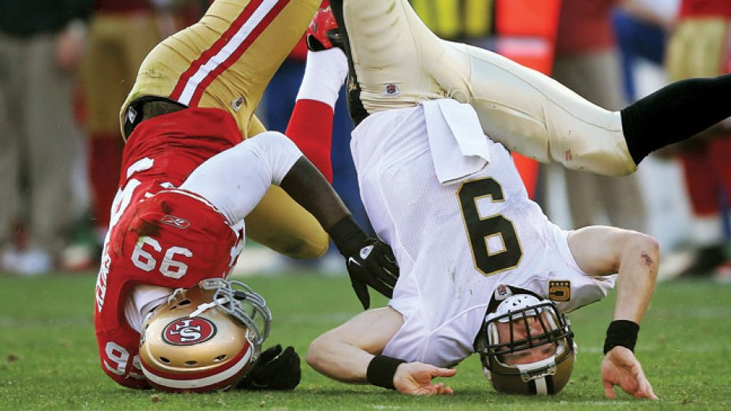
NBI-Plaintiff’s Personal Injury: Advanced Practice--Evidence
Future Medical Bills
Must have expert testimony for future medical bills.
Reed v. Scott, 1991 OK 113, 820 P.2d 445.
Notes:
Beware, expert testimony is needed to introduce the topic of future medical bills,
whether the injury is objective or subjective. Reed v. Scott,

Slide 16
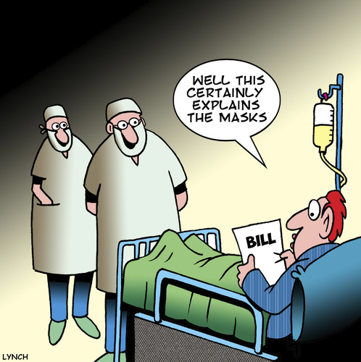
NBI-Plaintiff’s Personal Injury: Advanced Practice--Evidence
Paid versus incurred
The 3009.1 “Hurdle”
Notes:
That brings us to a fun and exciting topic for Plaintiff’s PI
Paid versus incurred. I think this was another Texas import

Slide 17
NBI-Plaintiff’s Personal Injury: Advanced Practice--Evidence
A. Upon the trial of any civil action arising from personal injury, the actual amounts paid for any services in the treatment of the injured party, including doctor bills, hospital bills, ambulance service bills, drug and other prescription bills, and similar bills shall be the amounts admissible at trial, not the amounts billed for such expenses incurred in the treatment of the party. If, in addition to evidence of payment, a party submits a signed statement acknowledged by the medical provider or an authorized representative or sworn testimony that the provider will accept the amount paid as full payment of the obligations, the statement or testimony shall be admitted into evidence. The statement or testimony shall be part of the record as an exhibit but need not be shown to the jury. If a medical provider has filed a lien in the case for an amount in excess of the amount paid, then the bills in excess of the amount paid, but not more than the amount of the lien, shall be admissible.
B. If no payment has been made, the Medicare reimbursement rates in effect when the personal injury occurred, not the amounts billed, shall be admissible if, in addition to evidence of nonpayment, a party submits a signed statement acknowledged by the medical provider or an authorized representative or sworn testimony that the provider will accept payment at the Medicare reimbursement rate less cost of recovery as provided in Medicare regulations as full payment of the obligation. The statement or testimony shall be admitted into evidence and shall be part of the record as an exhibit but need not be shown to the jury. If a medical provider has filed a lien in the case for an amount in excess of the Medicare rate, then the bills in excess of the amount of the Medicare rate, but not more than the amount of the lien, shall be admissible.
C. If no bills have been paid, or no statement acknowledged by the medical provider or sworn testimony as provided in subsections A and B of this section is provided to the opposing party and listed as an exhibit by the final pretrial hearing, then the amount billed shall be admissible at trial subject to the limitations regarding any lien filed in the case.
D. This section shall apply to civil actions arising from personal injury filed on or after November 1, 2015.
Notes:
Okay, did you get all that?
The good: says liened bills are the admissible amount
The odd: If no payments, Medicare rates admitted. If providers for
Some reason agree to accept that as payment in full
Don’t imagine this coming into play very often

Slide 18
NBI-Plaintiff’s Personal Injury: Advanced Practice--Evidence
A. Upon the trial of any civil action arising from personal injury, the actual amounts paid for any services in the treatment of the injured party, including doctor bills, hospital bills, ambulance service bills, drug and other prescription bills, and similar bills shall be the amounts admissible at trial, not the amounts billed for such expenses incurred in the treatment of the party. If, in addition to evidence of payment, a party submits a signed statement acknowledged by the medical provider or an authorized representative or sworn testimony that the provider will accept the amount paid as full payment of the obligations, the statement or testimony shall be admitted into evidence. The statement or testimony shall be part of the record as an exhibit but need not be shown to the jury. If a medical provider has filed a lien in the case for an amount in excess of the amount paid, then the bills in excess of the amount paid, but not more than the amount of the lien, shall be admissible.
B. If no payment has been made, the Medicare reimbursement rates in effect when the personal injury occurred, not the amounts billed, shall be admissible if, in addition to evidence of nonpayment, a party submits a signed statement acknowledged by the medical provider or an authorized representative or sworn testimony that the provider will accept payment at the Medicare reimbursement rate less cost of recovery as provided in Medicare regulations as full payment of the obligation. The statement or testimony shall be admitted into evidence and shall be part of the record as an exhibit but need not be shown to the jury. If a medical provider has filed a lien in the case for an amount in excess of the Medicare rate, then the bills in excess of the amount of the Medicare rate, but not more than the amount of the lien, shall be admissible.
C. If no bills have been paid, or no statement acknowledged by the medical provider or sworn testimony as provided in subsections A and B of this section is provided to the opposing party and listed as an exhibit by the final pretrial hearing, then the amount billed shall be admissible at trial subject to the limitations regarding any lien filed in the case.
D. This section shall apply to civil actions arising from personal injury filed on or after November 1, 2015.
Notes:
Finally, the biggy: makes “paid v. incurred” the law in OK
This was a bad day for our collateral source rule. So what does it do
Ostensibly, limits a plaintiff’s medical evidence to the amounts paid by
Insurance, Medicare, Medicaid, the like.
But lets drill down a bit

Slide 19
NBI-Plaintiff’s Personal Injury: Advanced Practice--Evidence
“Any Civil Action Arising From Personal Injury”
Notes:
The statute is bigger than just a plaintiff’s case versus a tortfeasor
It applies to any civil action “arising from” personal injury
Obviously applies to third party liability claim
But what about UM? I don’t see why not. Medpay? Again, why not

Slide 20
NBI-Plaintiff’s Personal Injury: Advanced Practice--Evidence
“Any Civil Action Arising From Personal Injury”
Notes:
So is it bad faith for a UM carrier, which has legal obligation to evaluate a claim
At the outset (unlike a TF), to make a UM offer that takes this statute into consideration
UM pays damages insured “legally entitled to recover from TF”
Seems that would necessarily take into account a statute that limits those damages

Slide 21
NBI-Plaintiff’s Personal Injury: Advanced Practice--Evidence
Notes:
Why are you looking at me? I don’t know the answer
Ask these folks. we may have some hints in the burden of proof in the statute
The statute is not self-executing, but the party wishing to limit medical
Evidence to the paid amount must satisfy the statutes burden

Slide 22
NBI-Plaintiff’s Personal Injury: Advanced Practice--Evidence
Don’t assume you are limited to the paid amount:
C. If no bills have been paid, or no statement acknowledged by the medical provider or sworn testimony as provided in subsections A and B of this section is provided to the opposing party and listed as an exhibit by the final pretrial hearing, then the amount billed shall be admissible at trial subject to the limitations regarding any lien filed in the case.
Notes:
The party wishing to limit you to the paid amount has to go to the providers
And get either a signed statement or get sworn testimony that the provider
Will accept the paid amount as full payment of the billing

Slide 23
NBI-Plaintiff’s Personal Injury: Advanced Practice--Evidence
Notes:
This has proved difficult for insurance companies since most doctors
Are reluctant to discuss billing and billing and legal departments are
Reluctant to sign anything for an attorney

Slide 24
NBI-Plaintiff’s Personal Injury: Advanced Practice--Evidence
Notes:
So watch out for the latest insurance company shenanigans
That was best picture I could find of an insurance company
What seeing: threatening looking letters sent to providers
Sign this statement or we will be forced to notice you for deposition

Slide 25
NBI-Plaintiff’s Personal Injury: Advanced Practice--Evidence
Notes:
Anybody seeing a different approach
In our case, we heard about the letter from the attorney for the provider
Defendant did not bother to include us in the mailing
judge denied our motion to quash. other judge’s quash these back door letters

Slide 26
NBI-Plaintiff’s Personal Injury: Advanced Practice--Evidence
Notes:
So back to the question whether it is bad faith for a UM
Carrier to presume it will ultimately obtain the statement or testimony
And on that basis to discount the medicals to the paid amount
Some good attorneys think that it is and others are not filing BF claims
On that basis

Slide 27
NBI-Plaintiff’s Personal Injury: Advanced Practice--Evidence
What does one do?
In light of Paid versus Incurred?
Notes:
Where does 3009.1 leave us? If the bills are liened, they come in as billed
But no longer get benefit of bigger billed amount when client has health insurance
But medical bills drives case value, right?
I used to apply a factor of 20. Routinely getting 20 x medicals (JK)

Slide 28
NBI-Plaintiff’s Personal Injury: Advanced Practice--Evidence
Medical Bills—who needs ‘em anyway?
Don’t put any Medicals into Evidence: http://www.gigaxlaw.com/medical-bills-in-personal-injury-trials-ask-the-jury-to-award-them-the-low-anchoring-effect-of-medical-expenses/.
Notes:
There is another way--Don’t put Medicals into Evidence
Many believe medical bills are anchor effect drives verdicts downward.
See the link in the slide and in materials for discussion
Or talk to the gentleman coming up after me
Often the jury will assume medical bills anyway, and assume they are greater than billed
And certainly greater than what is paid after Medicare gets its discounts

Slide 29
NBI-Plaintiff’s Personal Injury: Advanced Practice--Evidence
12 O.S. 2803(24): $25,000 hearsay exception
24. A verified or declared written medical report signed by a physician, provided:
a. the report is used in an action not arising out of contract in which the claim of the plaintiff is not in excess of Twenty-five Thousand Dollars ($25,000.00),
b. the report contains a history of the plaintiff, the complaints of the plaintiff, the physician’s findings on examination, and any diagnostic tests, description and cause of the injury, and the nature and extent of any permanent impairment. All opinions expressed in the report must be based upon a reasonable degree of medical probability, and
c. the medical report must be verified or contain a written declaration, made under the penalty of perjury, that the report is true.
Notes:
Last thing cover on medical bills: $25,000 hearsay exception
available where damages less than $25,000.
now with the increased small claim limit of $10,000, even more useful
The statute, you can see, in slide, is a checklist for a valid report
Find doctor who will write these ($200 or so)

Slide 30
NBI-Plaintiff’s Personal Injury: Advanced Practice--Evidence
E. Medical Records: Overcoming Objections
Notes:
Getting medical records admitted over objections
First, I say, don’t. Be very cautious dumping records wholesale in evidence
May find jury spends several hours combing for latest gossip about client
Did you know your client drinks a gallon of whiskey a day, smokes dope?
Beats his wife? Has VD? Then you didn’t read the medical records

Slide 31
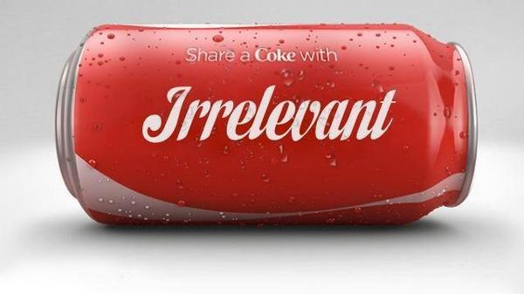
NBI-Plaintiff’s Personal Injury: Advanced Practice--Evidence
Keeping medical records out of evidence
Notes:
Maybe should be talking about keeping medical evidence out
How can we do that?

Slide 32
NBI-Plaintiff’s Personal Injury: Advanced Practice--Evidence
Medical privilege waiver (12 O.S. 2503(D)):
Medical privilege is waived as to any communication relevant to the physical, mental, or emotional, claims made pertinent by the patient in a legal proceeding.
But still the waiver is conditioned:
Nitzel v. Jackson, 1994 OK 49, 879 P.2d 1222, and Higginbotham v. Jackson, 1994 OK 8, 869 P.2d 319
Notes:
Medical privilege is waived by filing a PI suit.
But the waver was limited in scope to the parts of the body injured
And has reasonable time restrictions
We knew that from two cases Judge Jackson got mixed up in in 1995

Slide 33
NBI-Plaintiff’s Personal Injury: Advanced Practice--Evidence
Notes:
These case said that while there is qualified waiver of privilege
courts did not have power force patient to execute a medical authorization.
defendant was limited to “statutory” means of discovery.
That meant subpoena the providers, or in some cases, court order of release.

Slide 34
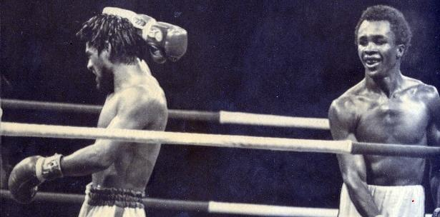
NBI-Plaintiff’s Personal Injury: Advanced Practice--Evidence
12 O.S. 3226(A)(2)(a):
Subject to subsection B of this section, in any action in which physical or mental injury is claimed, the party making the claim shall provide to the other parties a release or authorization allowing the parties to obtain relevant medical records and bills, and, when relevant, a release or authorization for employment and scholastic records.
Notes:
No mas. Discovery code now requires we execute appropriate authorizations
Medical, School, Work. Expect a new fight over whether the limitations still apply
The statute is rather bare-boned. Do the Jackson cases still apply?
What about Holmes v. Nightingale that says court can’t require ex parte communication
Still good law in light of the discovery change? I think so.

Slide 35
NBI-Plaintiff’s Personal Injury: Advanced Practice--Evidence
F. Creatively Using Motions in Limine
Notes:
Creatively using motions in limine. Latin for “at the threshold”
Opportunity to get pretrial ruling so you don’t look like an ideat
In front of jury (or poison jury), or piss off your judge
Can be used to keep something out, or get pretrial ruling
That something comes in

Slide 36
NBI-Plaintiff’s Personal Injury: Advanced Practice--Evidence
Remember rulings in limine are preliminary rulings
They do not form the record
So if you get an adverse limine ruling be sure to raise the issue at sidebar at the appropriate point in trial to preserve for appeal
Notes:
Limine rulings are preliminary and not part of the record
So be sure to raise the matter if you get a bad ruling
During trial to get it in the record
That means offer an objection with contested evidence is offered
Or make an offer of proof if you are trying to get something in

Slide 37
NBI-Plaintiff’s Personal Injury: Advanced Practice--Evidence
Motions in limine settle cases
Notes:
If everyone knows in advance that evidence of the gallon of vodka,
The dope, the VD and the wife beating is out of evidence
May help get case settled
We sometimes file a motion in limine months before trial or even due
Before a mediation about a particularly significant, but controversial evidence
Don’t file all the silly MILs months in advance, just if there are one or
Two significant bits of controversial evidence

Slide 38
NBI-Plaintiff’s Personal Injury: Advanced Practice--Evidence
Motions in limine educate the judge
Notes:
the attorneys know the most about the case
Use motions in limine to educate judge
In advance, away from the time-pressure of trial
This allows you a better opportunity for calm persuasion
3009.1 good one—provider statements or testimony

Slide 39
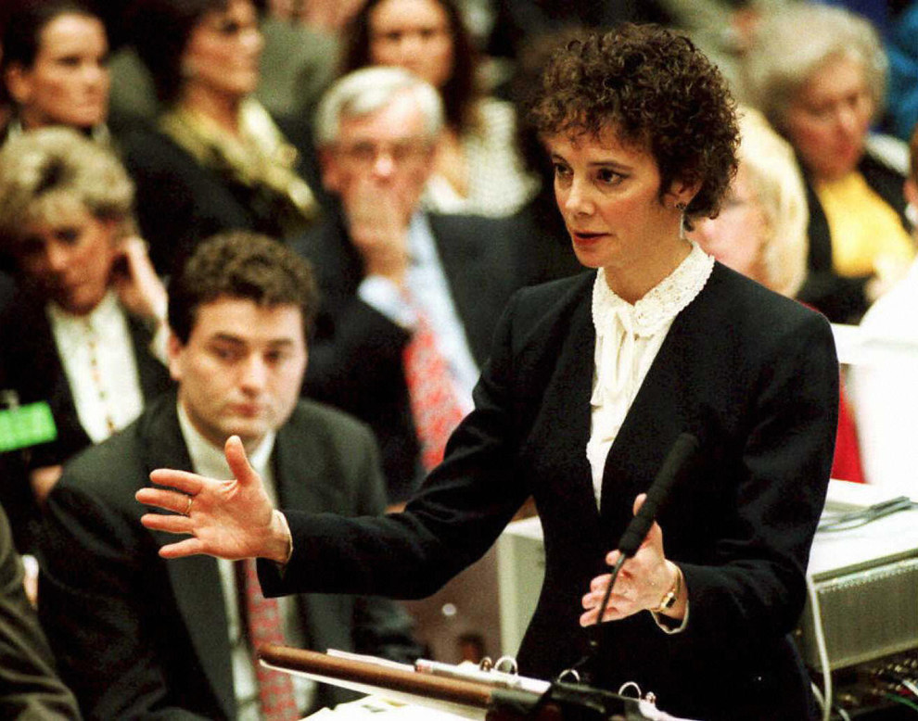
NBI-Plaintiff’s Personal Injury: Advanced Practice--Evidence
Motions in limine open up your opening
Notes:
If you know a particular piece of evidence will come in
You know you can discuss it in opening
This can prevent you from getting slapped by judge during opening
But also from looking like a dimwit for promising the jury something
that gets excluded in trial

Slide 40
NBI-Plaintiff’s Personal Injury: Advanced Practice--Evidence
Comb the deposition for limine snippets
Notes:
read the depositions. Amazing what clients say during those things
Was your client asked about something that might be inadmissible
lack of license, convictions, drug use, prior “bad” acts, collateral source evidence
Usually short, to the point—cite the rule and articulate why outright inadmissible,
or why probitive value is substantially outweighed by the prejudicial effect.

Slide 41
NBI-Plaintiff’s Personal Injury: Advanced Practice--Evidence
Remember MIL does not preserve error, since they really are only preliminary rulings that stand or fall based upon the actual evidence at trial. Must reassert at trial by way of objection to the evidence when offered, or offer of proof at the appropriate time.
Notes:
Worht saying again—reassert your objection or
offer of proof at appropriate time. don’t Preserve error otherwise

Slide 42
National Business Institute (NBI) Plaintiff’s Personal Injury: Advanced Practice
Section IV. Evidence: Overcoming Admission Hurdles with Medical Bills and Records
By: Paul Kouri
December 18, 2017
Oklahoma City, Oklahoma
Notes:
And with that, I turn you over to David Bernstein for
Deposing the Defendant’s Experts and Corporate Personnel
Thank you

